Slide 1
CIS117 Week 5
Environmental variables, PATH and editors

Slide 2
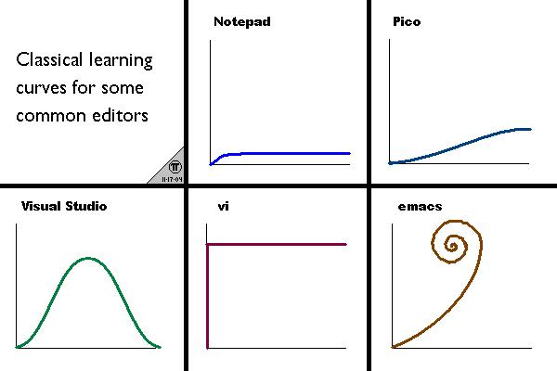
VI
Modal editor
Command Mode
Insert Mode
Last Line Mode
http://www.terminally-incoherent.com/blog/2006/08/01/text-editor-learning-curves/to add text

Slide 3
VI help
Web links with help
Cheat sheet
https://vim-adventures.com

Slide 4
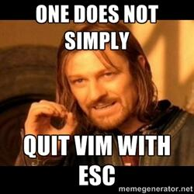
VI tips and tricks
Common Commands (Case Matters!)
Esc to go back to command mode
:wq to save and exit
:q! To get out of edit without saving
Common Mistakes
:q! At the wrong time
In the wrong mode
Using a mouse
https://twitter.com/iamdevloper/status/435555976687923200

Slide 5
In Class activity
Go to http://vim-adventures.com
Get through level 1

Slide 6
Environmental variables
Used to keep track of things on system
Global variables are all upper case
PATH places to look for files
HOME the home directory

Slide 7
Environmental variables cont
set with no arg shows variables
printenv displays environmental variables
Echo $PATH shows individual variables
set can change values
DANGER HERE Linux will let you be stupid and not give warnings

